Slide 1
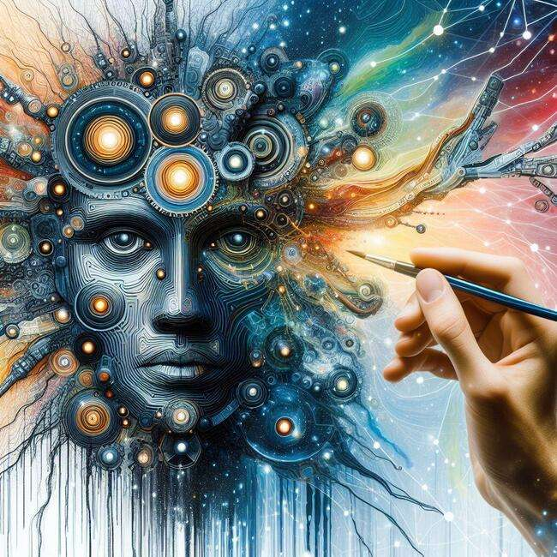
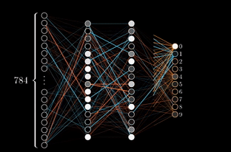
Perceptron Timeline
TEAM: FUTURE AI WIZARDS
“A Giant Leap For Mankind and AI”

Slide 2

What is the Perceptron?
The perceptron is a type of learning algorithm for neural networks.
The perceptron algorithm is a single-layer neural network, which means that it has one layer of neurons.
Multi-layer perceptrons (MLPs) are an extension of the perceptron algorithm that have multiple layers of neurons.

Slide 3
Image Recognition (2012): The AlexNet model's victory in the ImageNet Large Scale Visual Recognition Challenge marked a pivotal moment in the field of computer vision and deep learning.
Reinforcement Learning - AlphaGo (2016): AlphaGo, developed by DeepMind, defeating world champion Lee Sedol in the game of Go was a landmark event. This demonstrated the power of deep learning combined with reinforcement learning, especially in a game known for its depth and complexity, highlighting significant progress in AI's decision-making and strategic planning capabilities.
Natural Language Processing (NLP) and Transformers (2018): The Transformer model marked a groundbreaking advancement in Natural Language Processing (NLP), revolutionizing the way machines understand and generate human-like text.
GPT-3 and the Surge of Large Language Models (2020): The release of GPT-3 by OpenAI marked a significant advancement in language models.
Development of Multimodal AI Models (2021-2023): The emergence of multimodal AI models like OpenAI's DALL-E and CLIP, which understand and generate content that combines text and images represent a leap in AI's ability to understand context and content across different data types, indicating a move towards more versatile and integrated AI systems.
Introduction of the Perceptron (1943): Warren McCulloch and Walter Pitts introduce the concept of the perceptron in their paper "A Logical Calculus of Ideas Immanent in Nervous Activity."
Frank Rosenblatt's Perceptron: Mark I Perceptron Machine (1957): This was the first practical step towards neural networks and a foundational moment in machine learning.
Backpropagation (1986): The training of multi-layer neural networks occurred with the introduction of the backpropagation algorithm by David Rumelhart, Geoffrey Hinton, and Ronald J. Williams.
Development of Convolutional Neural Networks (CNNs) (1998): LeCun's work on Convolutional Neural Networks (CNNs), starting with the development of LeNet-5, marked a significant advancement in the field of neural networks, particularly in their ability to process visual data.
Big Data and Increased Computational Power (Early 2000s): The availability of big data and the increased computational power through the utilization of GPUs. This combination played a pivotal role in enabling deep learning models to process massive datasets.
Quick Outline

Slide 4
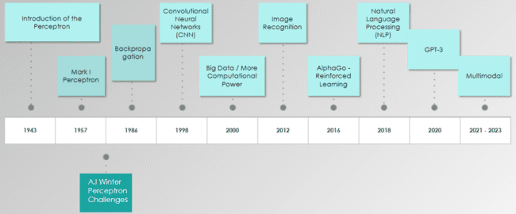
Perceptron TimeLine - Over The Years

Slide 5
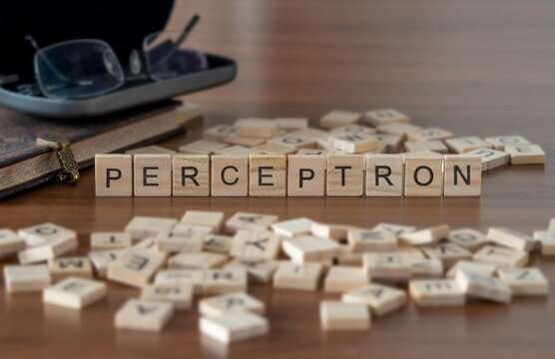
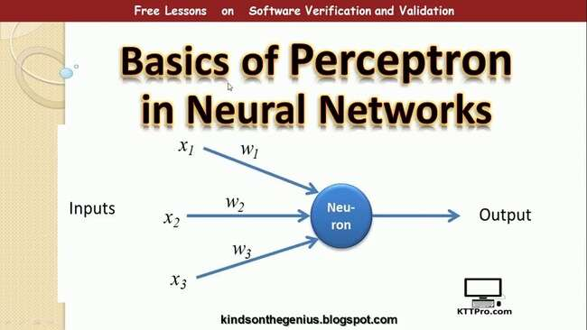
Invention of Perceptron by McCulloch and Pitts
(1943)
The perceptron, developed by Warren McCulloch and Walter Pitts in 1943, is one of the earliest models of an artificial neuron. It laid the foundation for the field of artificial neural networks and contributed significantly to the development of artificial intelligence. The perceptron is a binary classifier that takes multiple binary inputs and produces a single binary output, making it a fundamental concept in neural network theory.

Slide 6
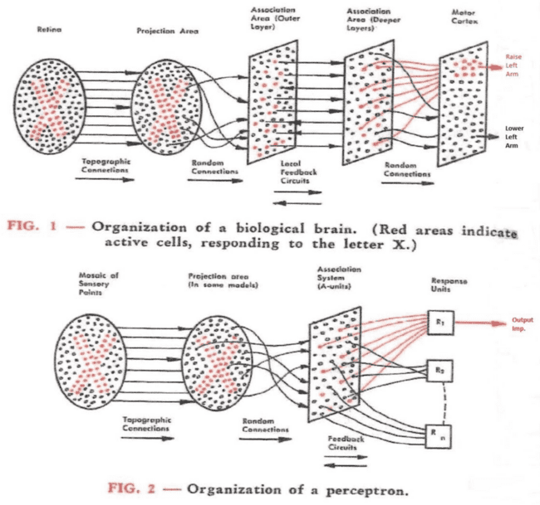
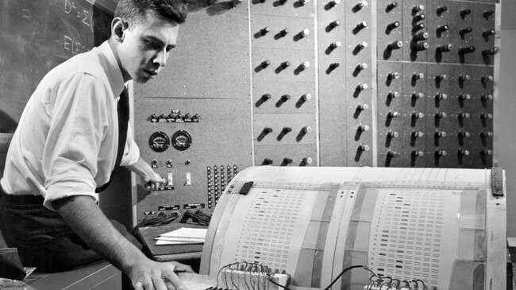
Inception of the Perceptron (1957)
Frank Rosenblatt develops the Mark I perceptron machine at Cornell Aeronautical Laboratory. It was designed for pattern recognition tasks and contributed to the early exploration of neural networks in AI. While perceptrons have evolved over time, this milestone laid the groundwork for subsequent developments in neural network research and the broader field of machine learning.

Slide 7

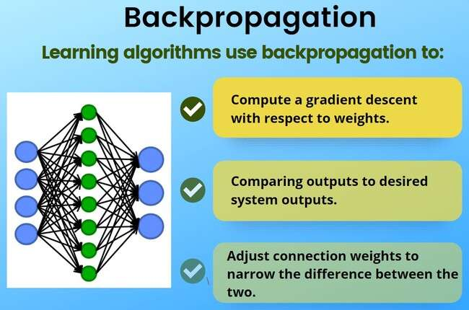
Introduction of Backpropagation
(1986)
The training of multi-layer neural networks occurred with the introduction of the backpropagation algorithm by David Rumelhart, Geoffrey Hinton, and Ronald J. Williams. This algorithm addressed crucial limitations that earlier models, including the perceptron, faced in handling complex, non-linear problems.

Slide 8

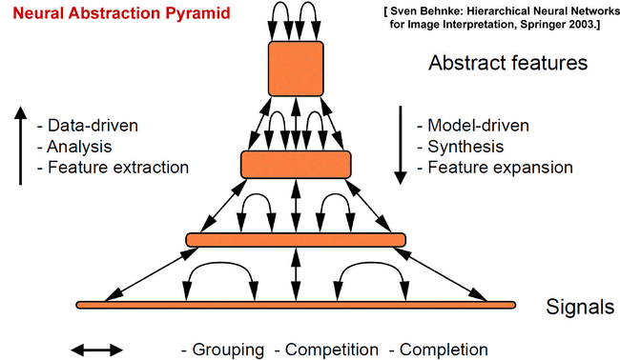
Development of Convolutional Neural Networks (CNNs)
(1998)
Yann LeCun's development of LeNet-5 and the introduction of CNNs represented a groundbreaking advancement in the ability of neural networks to process visual data, setting the stage for the widespread adoption of deep learning in computer vision applications

Slide 9
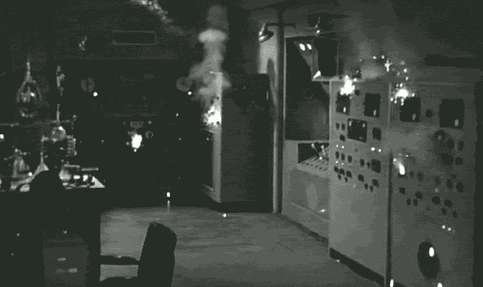
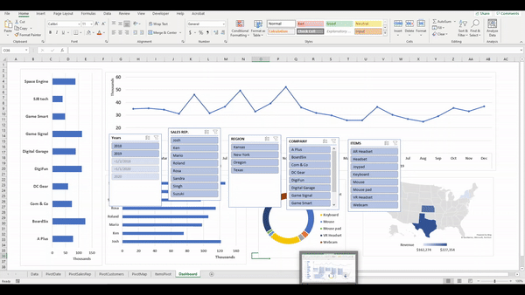
Foundational Role of Big Data and Increased Computational Power
(Early 2000s)
In the early 2000s, a transformative shift occurred in the field of deep learning, driven by the convergence of two crucial factors: the availability of big data and the increased computational power, particularly through the utilization of Graphics Processing Units (GPUs). This combination played a pivotal role in enabling deep learning models to process massive datasets, resulting in significant improvements in performance.

Slide 10

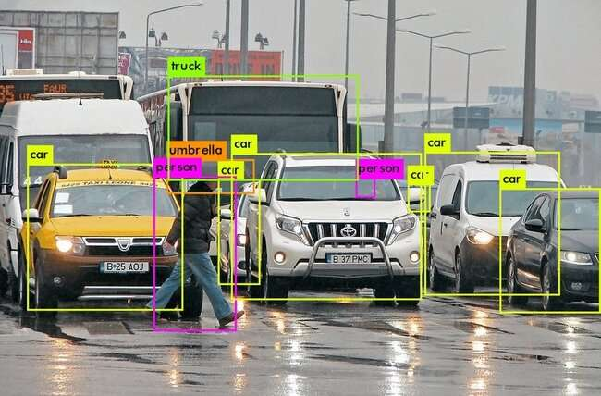
Achievement of Human-level Performance in Image Recognition
(2012)
The AlexNet model's victory in the ImageNet Large Scale Visual Recognition Challenge marked a pivotal moment in the field of computer vision and deep learning. This achievement signaled a significant breakthrough as deep learning models began to surpass human-level performance in specific tasks.

Slide 11
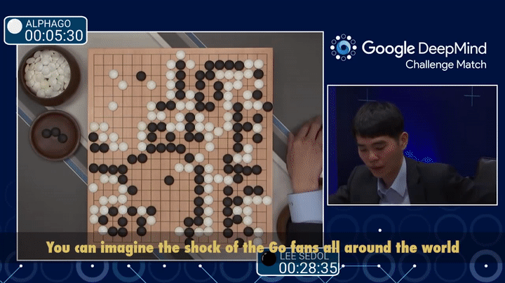

Advances in Reinforcement Learning - AlphaGo (2016)
AlphaGo's victory in 2016 marked a watershed moment in the field of artificial intelligence, demonstrating the prowess of deep learning and reinforcement learning in conquering challenges previously thought insurmountable. The success in Go showcased the potential of AI in decision-making and strategic planning, leaving a lasting impact on the trajectory of AI research and its applications.

Slide 12
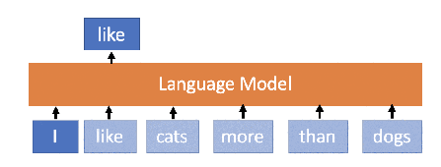
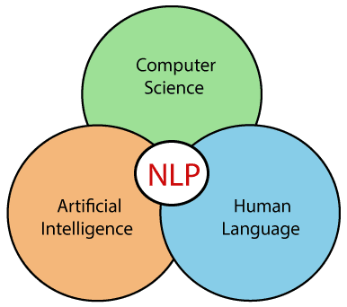
Advancements in Natural Language Processing (NLP) and Transformers
(2018)
The introduction of the Transformer model in 2018 revolutionized NLP by addressing long-range dependencies and enabling efficient parallelization. This breakthrough led to the development of models like BERT and GPT, which significantly improved the ability of machines to understand and generate human-like text, impacting a wide range of applications in natural language processing.

Slide 13
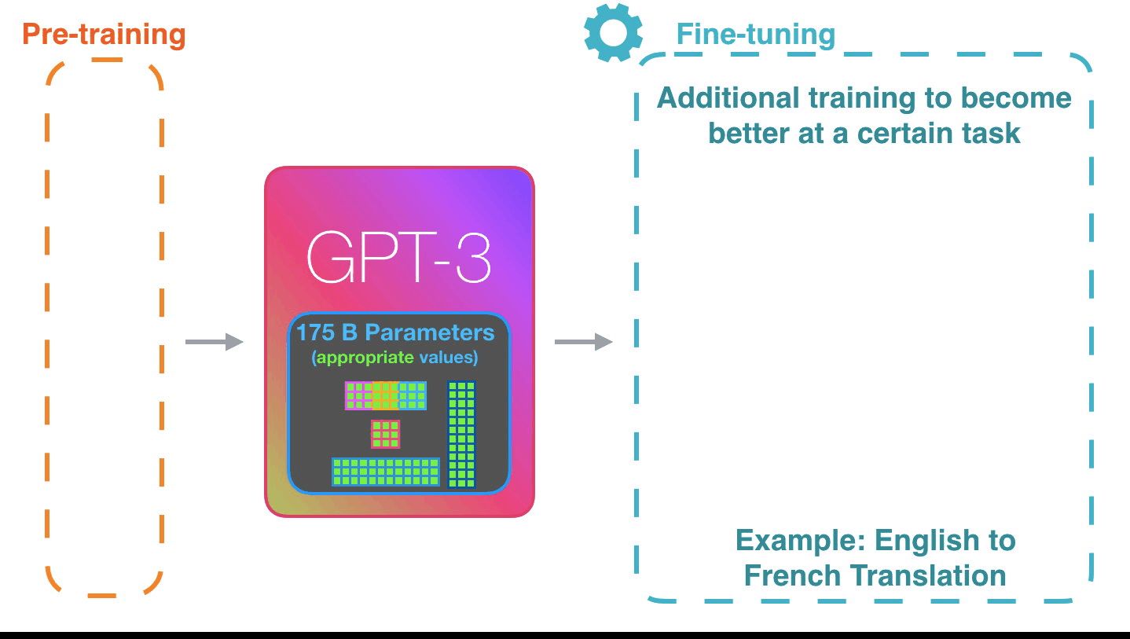
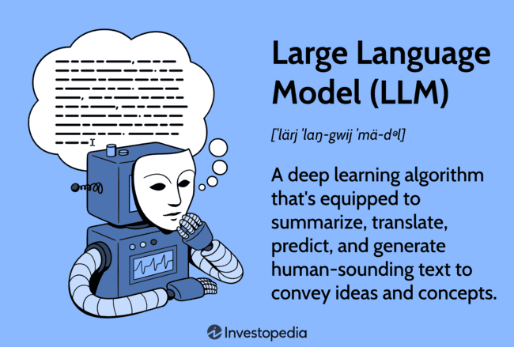
GPT-3 and the Surge of Large Language Models
(2020)
The release of GPT-3 (Generative Pre-trained Transformer 3) in 2020 marked a significant milestone in the field of natural language processing (NLP) and artificial intelligence. GPT-3, developed by OpenAI, represents one of the largest language models ever created, and its release sparked a surge in the development and exploration of large language models.

Slide 14
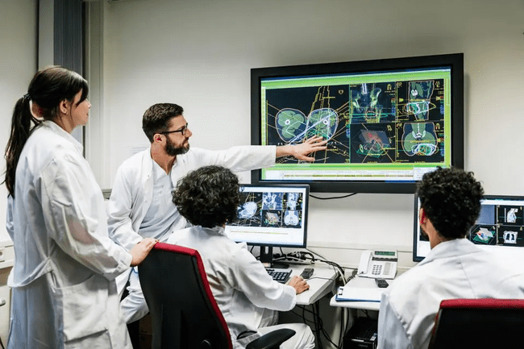
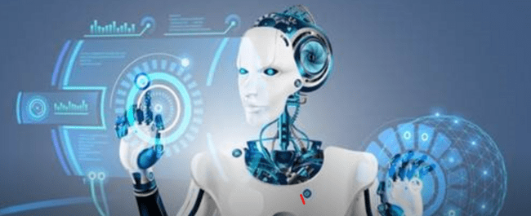
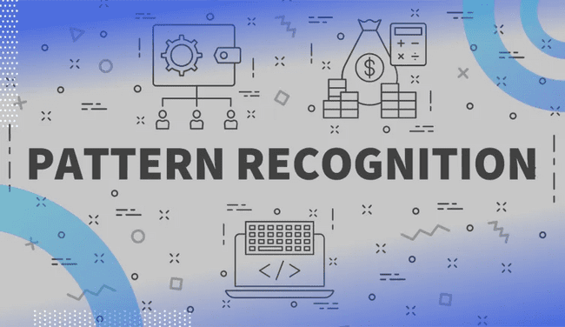

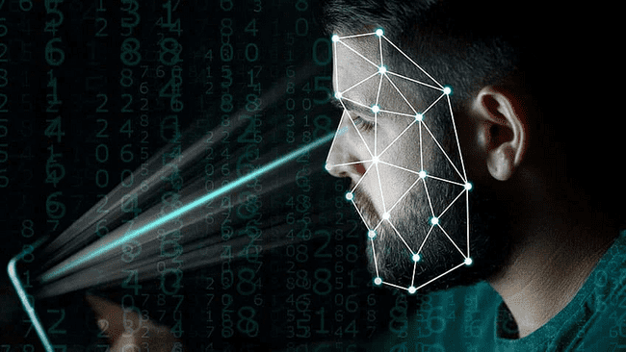
Real Life Applications of the Perceptron
TODAY
FUTURE
Medical Diagnosis
Robotic Control Systems
Pattern Recognition
Facial Recognition
Autonomous Vehicles

Slide 15
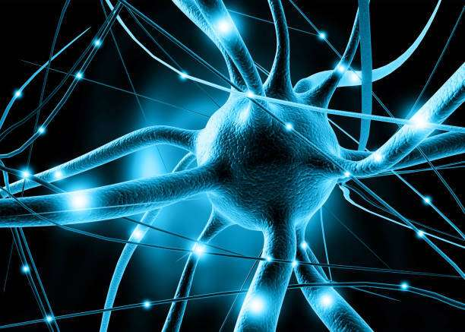
PERCEPTRON CHALLENGES:
How Challenges were overcome:
The introduction of the Multilayer Perceptron (MLP) and the backpropagation algorithm overcame the perceptron limitations by adding hidden layers, allowed it to solve complex (non linear) problems. Backpropagation allowed efficient model training by pushing errors backward and adjusting the weight(s).
Challenges:
XOR or “exclusive OR” - The perceptron, by itself, is linear - the results return as true if one of the inputs are true, and false otherwise. For complex modeling there are more than two value inputs so there could be many trues and many falses - which would result in the default output of false.
The above limitation greatly held back additional breakthroughs which eventually led to a decline in interest and funding for the research causing an AI WINTER

Slide 16
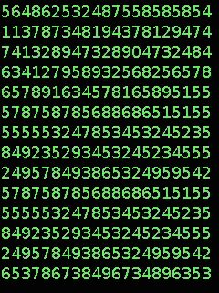
INFLUENTIAL LITERATURE:
"A Logical Calculus of Ideas Immanent in Nervous Activity" (1943): Authors Warren McCulloch and Walter Pitts introduced the concept of a simplified artificial neuron, laying the foundation for neural network models.
"The Perceptron, a Perceiving and Recognizing Automaton" (1957): Frank Rosenblatt's paper where he introduced the perceptron model, a type of artificial neuron capable of learning.
A LOGICAL CALCULUS OF THE IDEAS IMMANENT IN NERVOUS ACTIVITY* 1. Introduction. Theoretical neurophysiology rests on certain card
The Perceptron, a Perceiving and Recognizing Automaton Project Para - F. Rosenblatt - Google Books
"Learning representations by back-propagating errors" (1986): David Rumelhart, Geoffrey Hinton, and Ronald Williams' paper rediscovered and popularized the backpropagation algorithm for training multilayer neural networks.
"Principles of Neurodynamics: Perceptrons and the Theory of Brain Mechanisms" (1958): Frank Rosenblatt's book expanded on the perceptron model and its applications.
[PDF] Learning representations by back-propagating errors | Semantic Scholar
Principles of Neurodynamics: Perceptrons and the Theory of Brain Mechanisms - Frank Rosenblatt - Google Books

Slide 17
References:
Memon, Quratulan (2024). XOR problem in neural network. educative.io. https://www.educative.io/answers/xor-problem-in-neural-network
Lefkowitz, Melanie (2019, September), Professor's perceptron pabved the way for AI - 60 years too soon. cornell.edu. https://news.cornell.edu/stories/2019/09/professors-perceptron-paved-way-ai-60-years-too-soon
Simplilearn, (2023, Aug 14), Pattern Recognition and Machine Learning: Overview, Importance, & More, simplilearn.com, https://www.simplilearn.com/pattern-recognition-and-ml-article
Kurnaiwan, Dede (2023, Jan 25), Several Real-World Applications of Various Artificial Nural Network Architecture, plainenglish.io, https://ai.plainenglish.io/several-real-world-applications-of-various-artificial-neural-network-architecture-4e11027d5dfd
Nielsen, M. A. (1970, January 1). Neural networks and deep learning. http://neuralnetworksanddeeplearning.com/chap2.html
Andrews, E. L., & Lynch, S. (2020, July 23). How large language models will transform science, society, and ai. Stanford HAI. https://hai.stanford.edu/news/how-large-language-models-will-transform-science-society-and-ai
History of the Perceptron. (n.d.). https://home.csulb.edu/~cwallis/artificialn/History.htm

Slide 18
